Slide 1


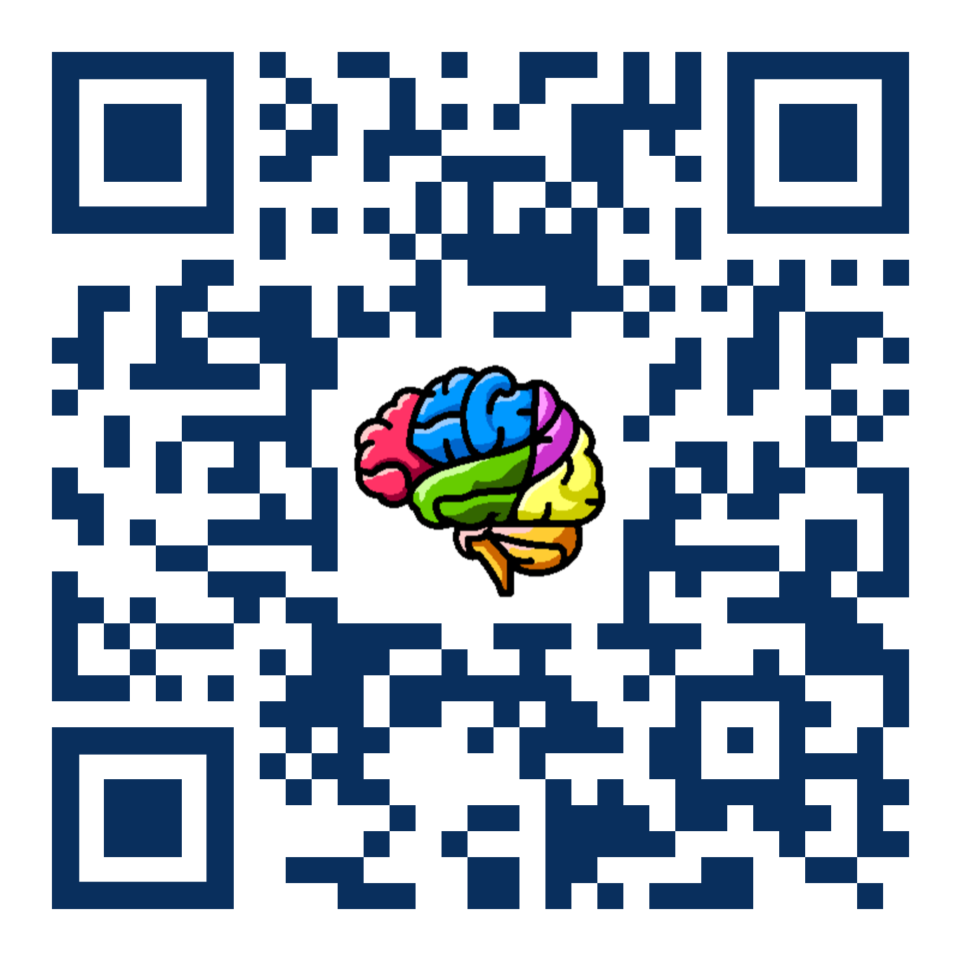
NiChart
AI²D
Notes:
ADD PENNSIVE LOGO

